Slide 1
Developing Stem Cell- and Differentiation Program Reporter Cell Lines in CRC
February 25, 2021
David Chen & Sandor Spisak

Slide 2
Genetic alterations in CRC block differentiation
BMP
Lumen
WNT pathway activation
(e.g. APC inactivation)
Stem cell
Expansion
Dysplastic Crypts
Differentiate
Mitogen pathway stimulation
(e.g. KRAS/BRAF mutation)
Villus
Early Adenoma
Uncontrolled
Proliferation
BMP/TGF-β pathway alteration
(e.g. SMAD4 alteration)
Stem cell
Late Adenoma
Insensitivity to
Differentiation
Crypt
TP53 mutation
WNT
Genome
Instability
Carcinoma
Current therapeutic directions are not effective!

Slide 3
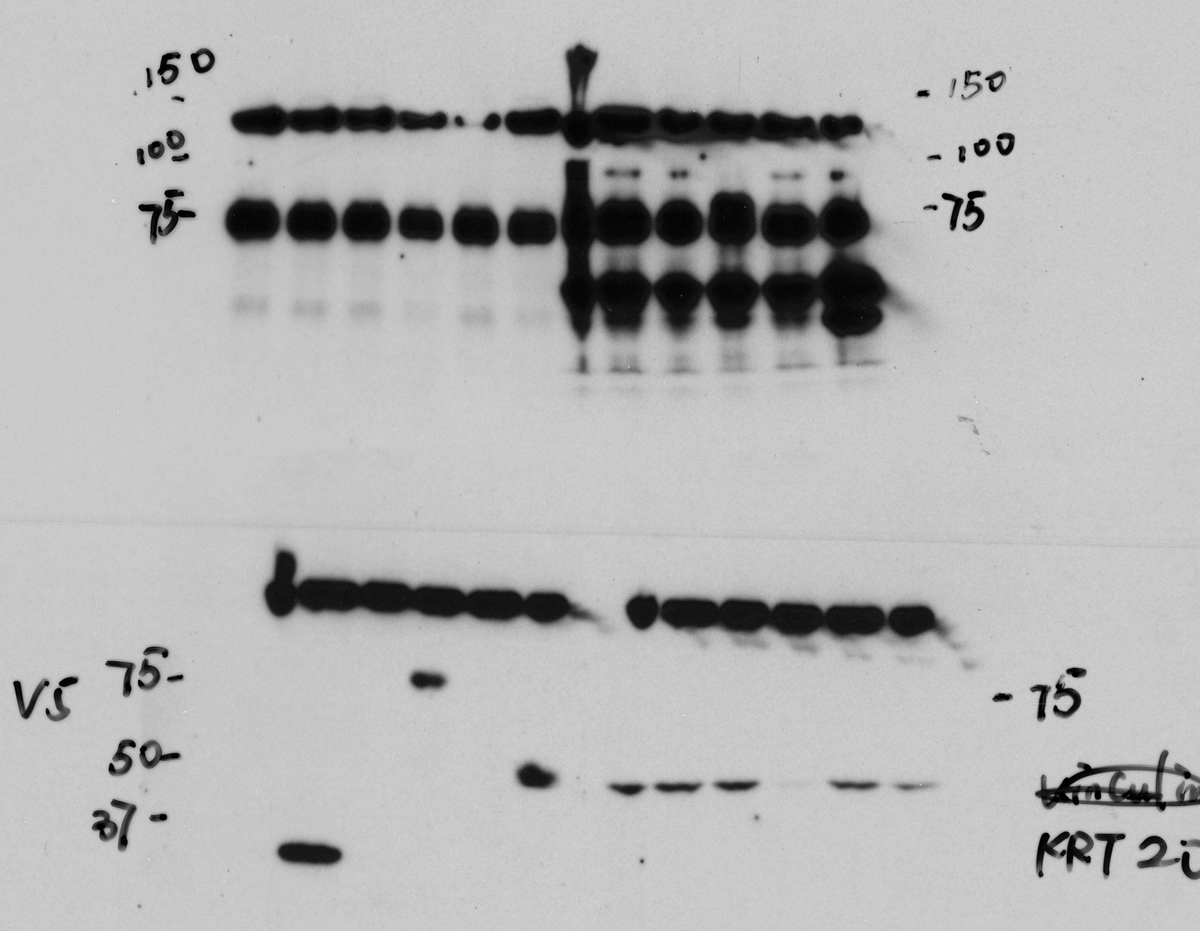
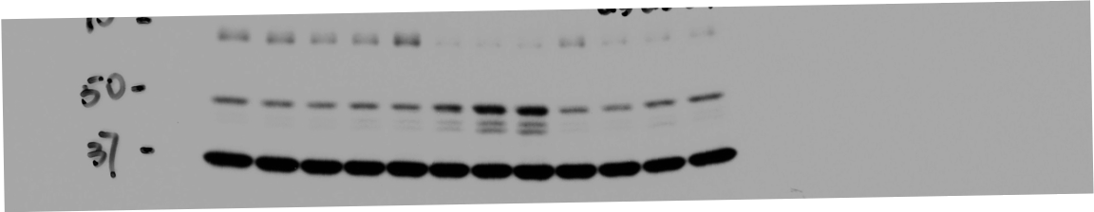
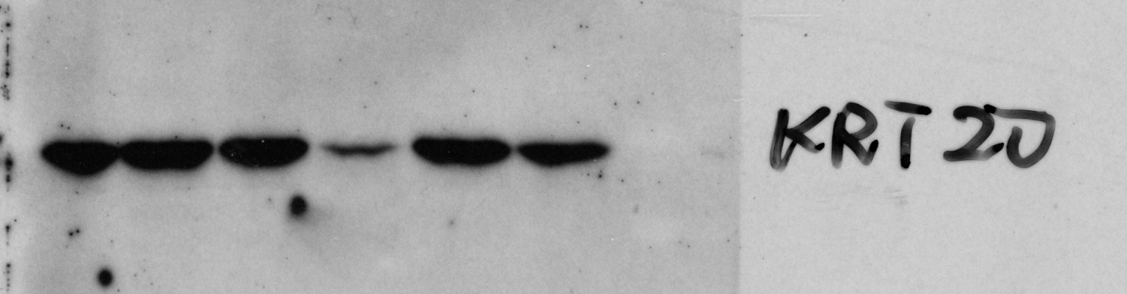
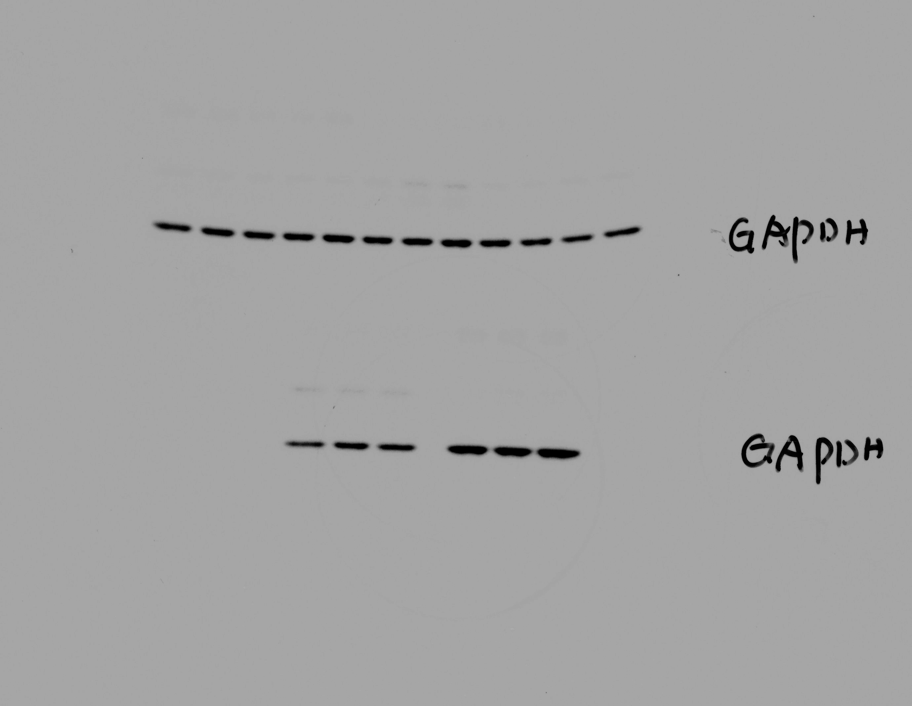
SOX9 Blocks Differentiation
HT-115
LS180 (SOX9 HET)
NTC
shRNA#1
GFP
SOX9
SOX9^{∆C}
dox:
-
3d
5d
7d
-
3d
5d
7d
dox
-
+
-
+
-
+
SOX9
SOX9
V5
SOX9^{∆C}
GFP
KRT20
KRT20
GAPDH
GAPDH

Slide 4
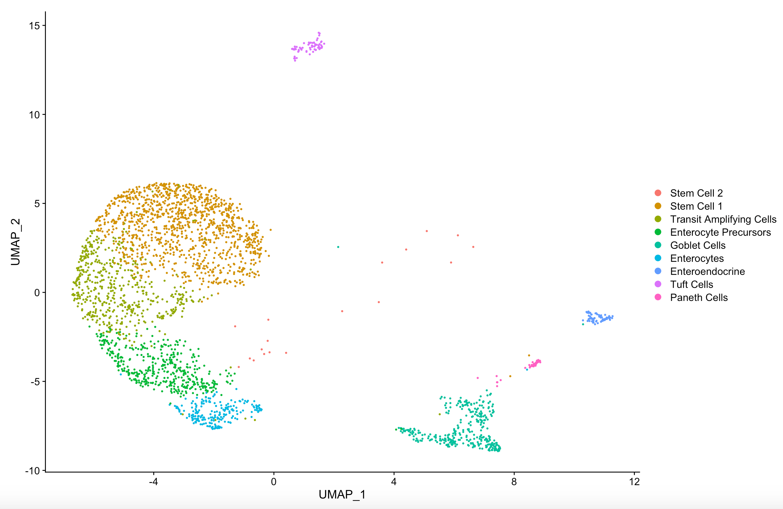
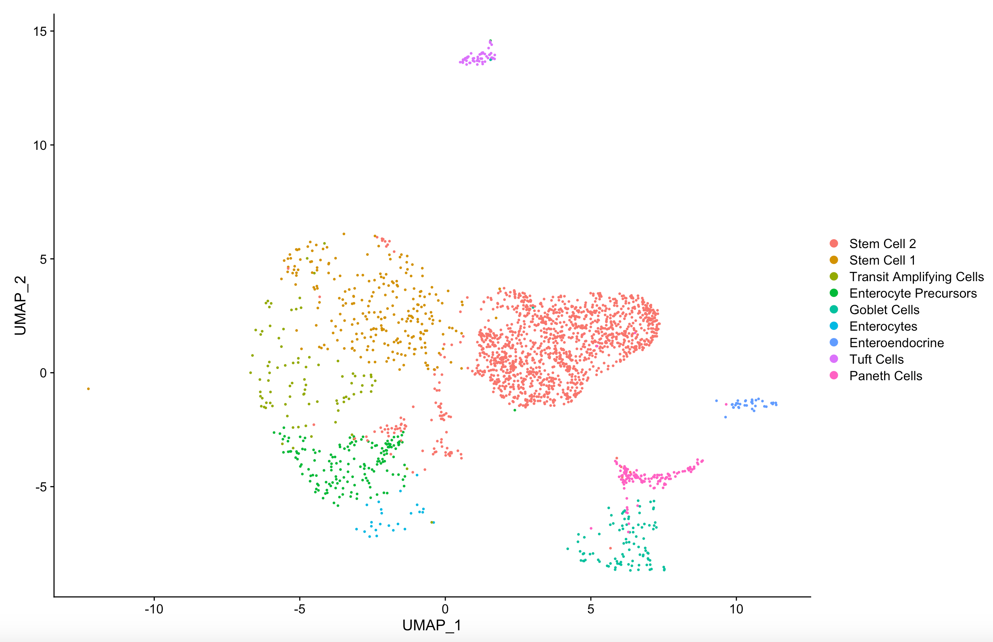
Contribution from APC^{WT} vs APC^{KO}
15
APC^{WT}
APC^{KO}
10
5
UMAP-2
0
-5
-10
-8
-4
0
4
8
12
-10
-5
0
5
10
UMAP-1

Slide 5
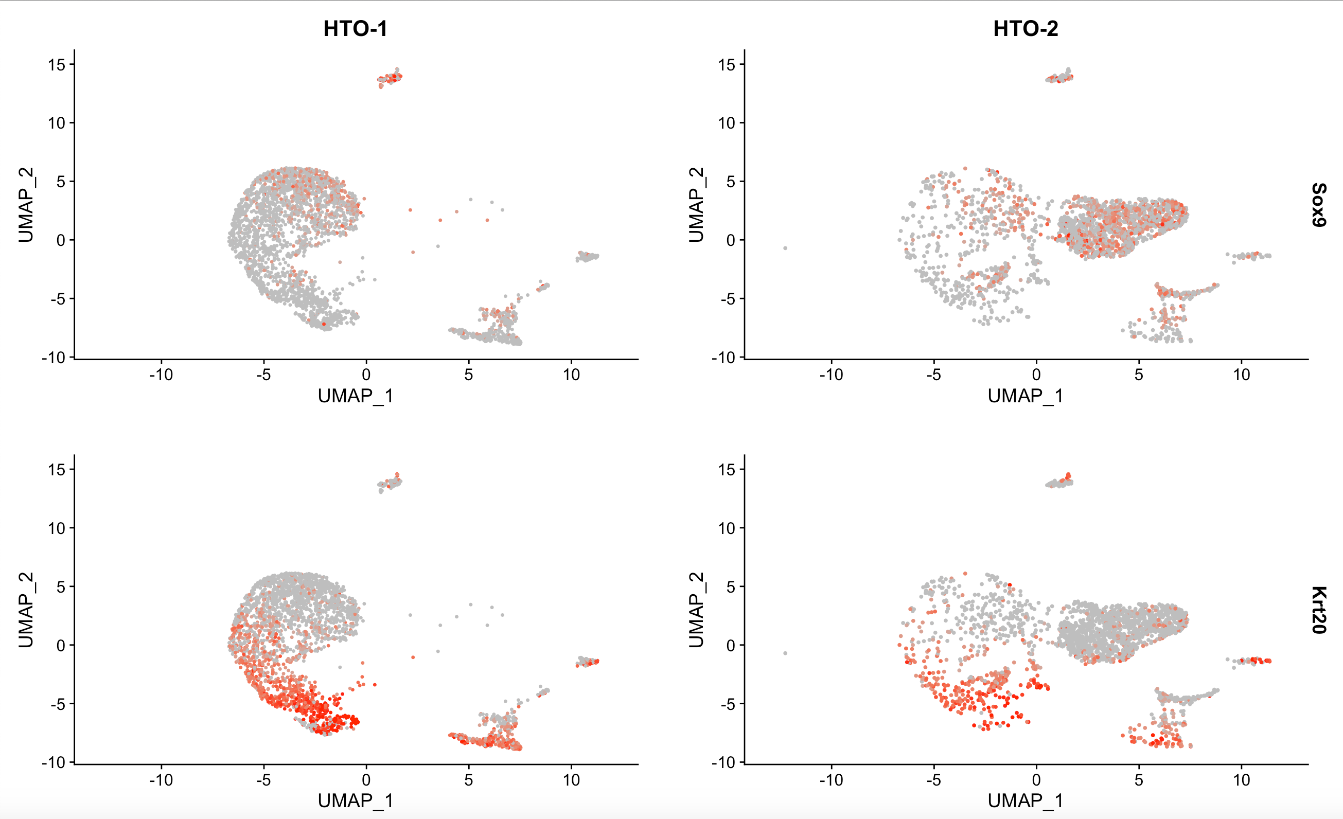
APC^{WT}
APC^{KO}
SOX9
KRT20

Slide 6
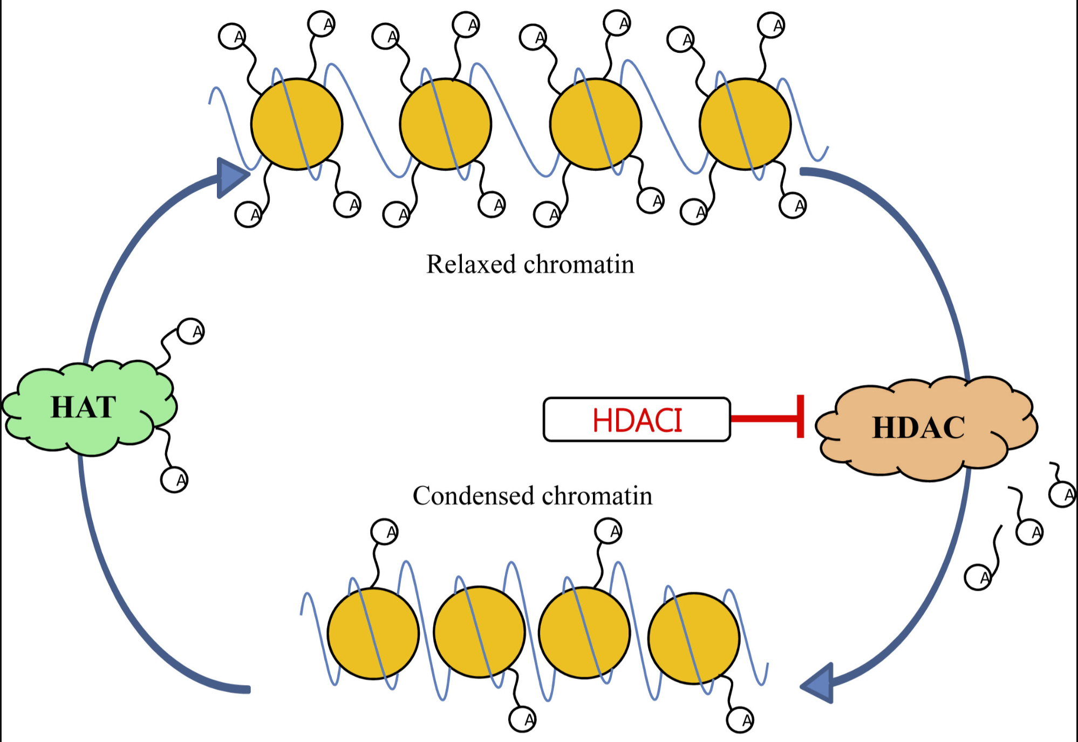
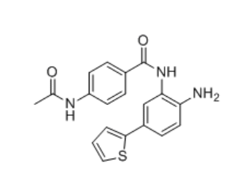

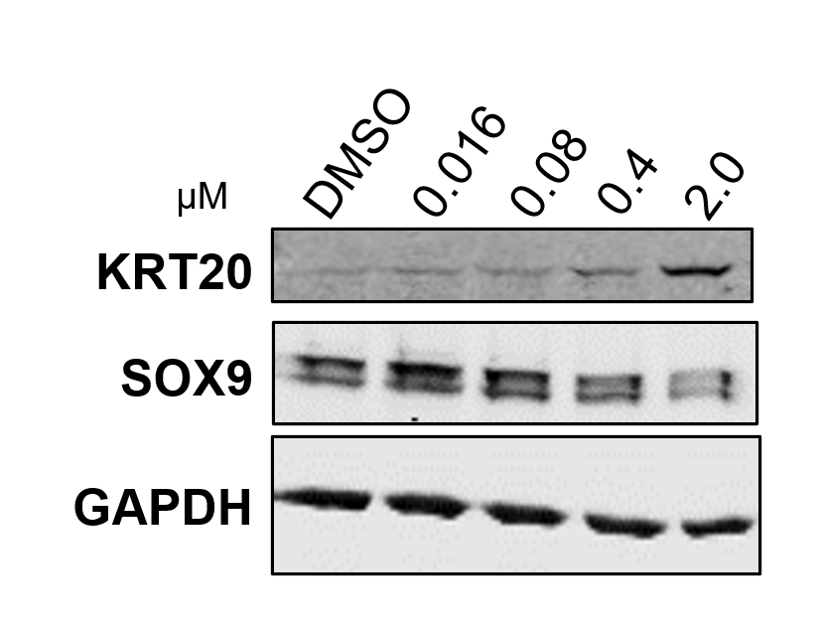
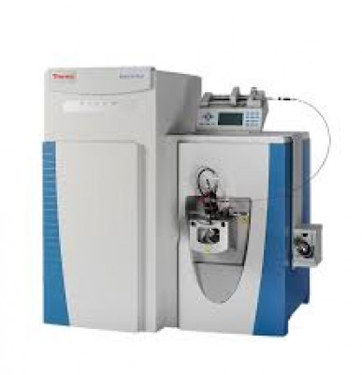
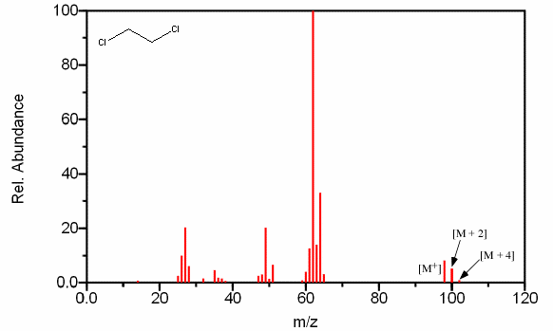
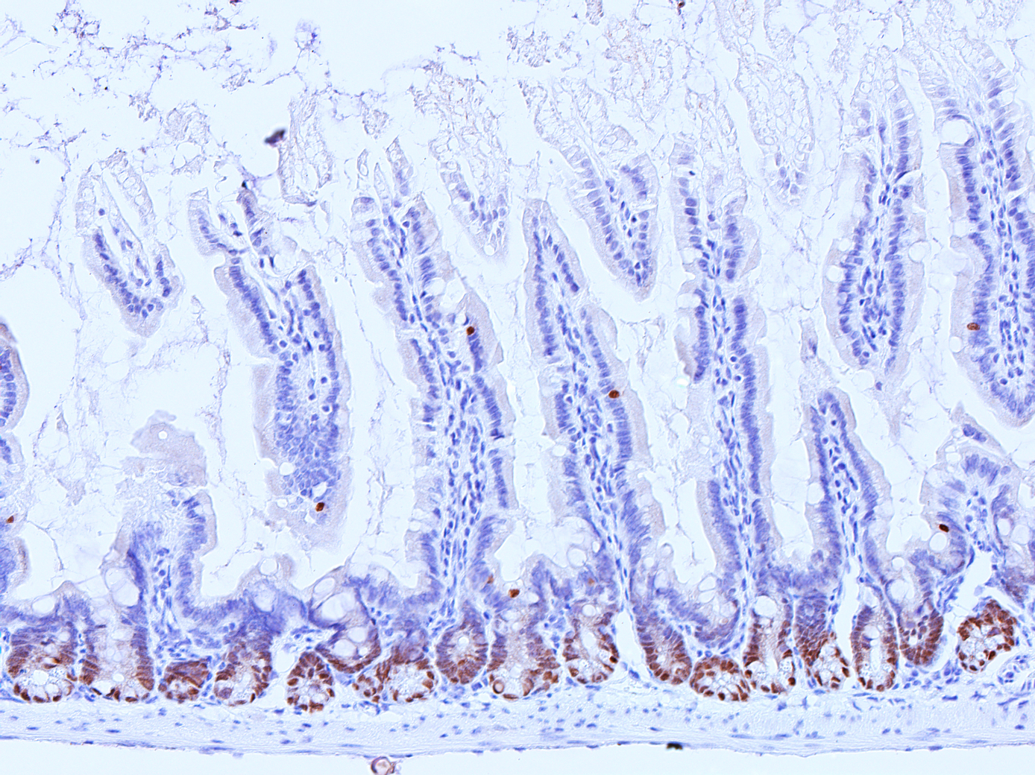
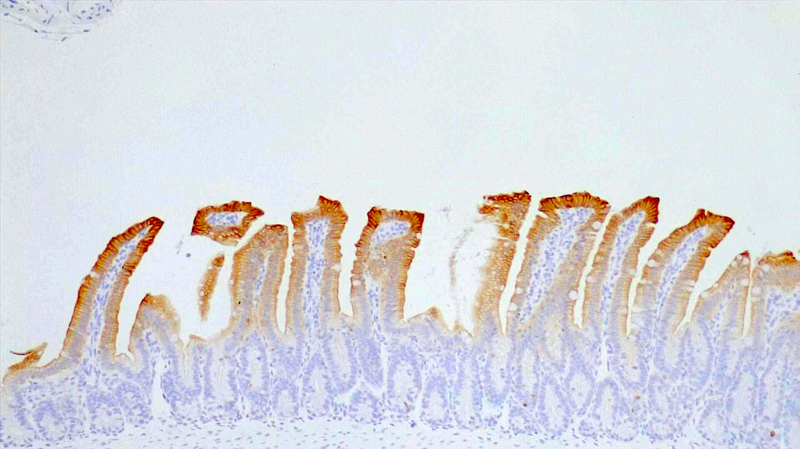
SOX9 as a key player…
Interactors
Co-factors
Stability
Activity
Regulators
Merck60
SOX9
Y
V5
X
SOX9
Targets
Differentiation
Stem Cell Program
Mass Spectrometry
Sox9 IHC
Krt20 IHC

Slide 7
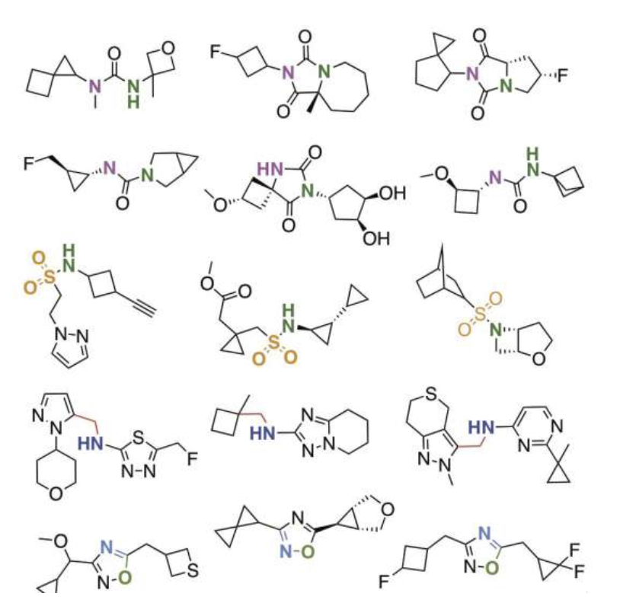
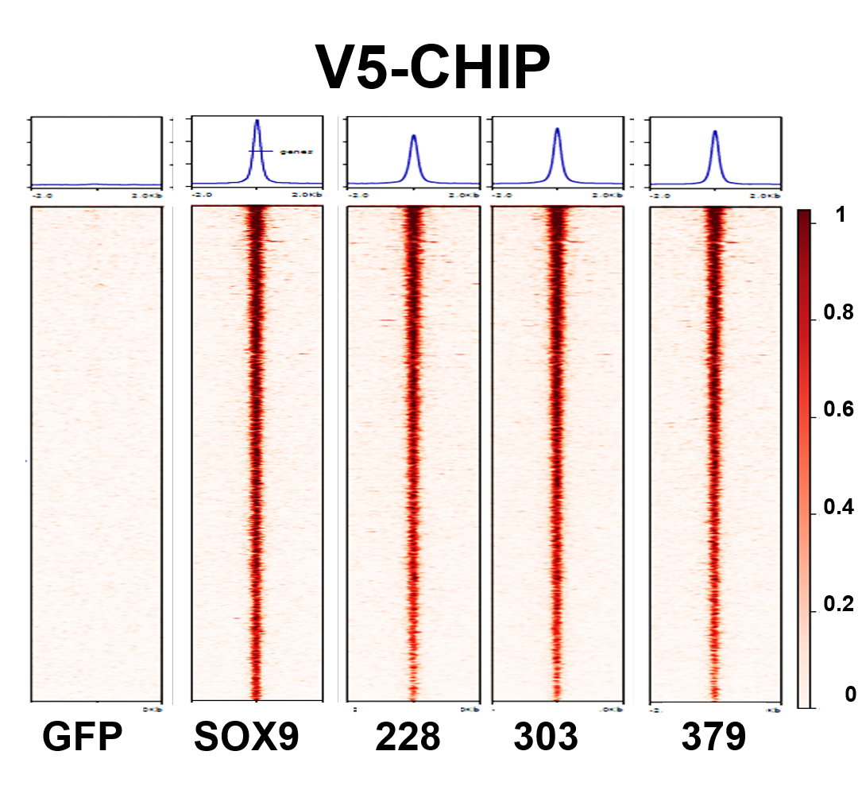
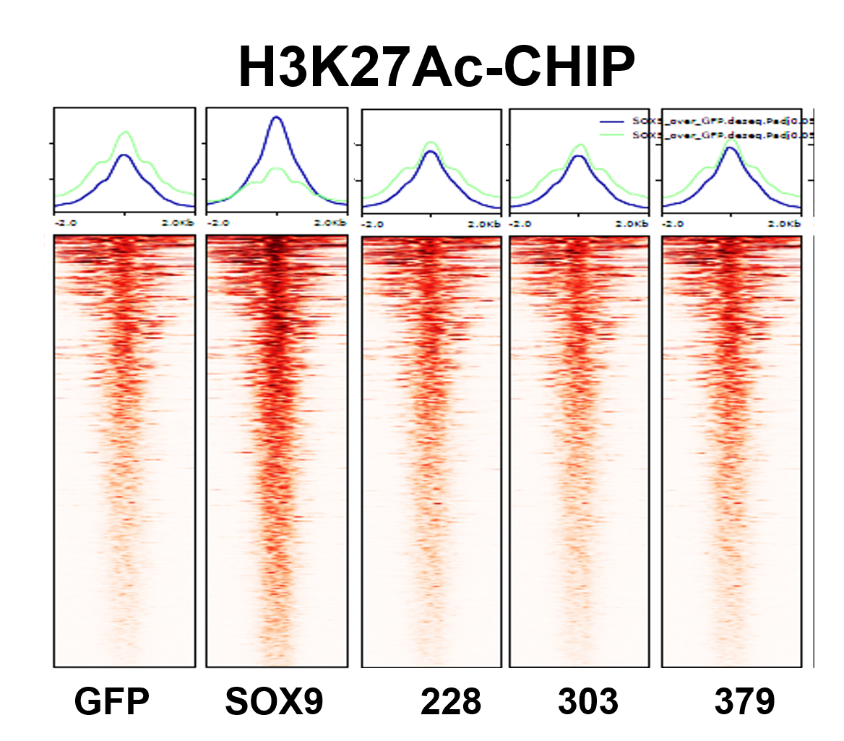
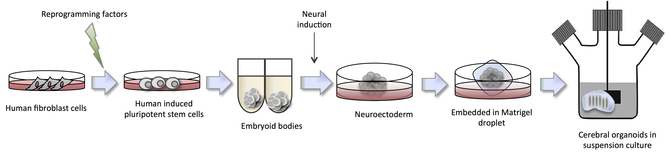
Experimental Approaches Using Reporter System
RIME
(Paul)
Drug Screens
(Pranshu)
Y
V5
X
SOX9
T2A
GFP
Neo
SOX9
15
SMARCC2
5.5
0
SATB2
TCF20
WRNIP1
SMARCC1
3.5
WDHD1
0
OGT
TCEA1
TRIM24
SON
SOX9
CBX5
NIPBL
KDM3B
EP300
CYB5R3
0
HTATSF1
DDX23
NCOR1
Stem Cell Reporter
System
CHD5
ADNP
PTBP3
DHX16
BRD2
DEK
IRF2BP1
TPI1
ZMYM3
CD2BP2
PPP1R8
SMARCD1
ZNF687
CBR1
CNDP2
CTBP1
ACOT13
PPIL1
MBD2
NOSIP
PPIE
POLR2A
Genetic Screens
(David)
NOP58
TFAP4
QRICH1
VGLL4
SMARCB1
PREP
DHX38
HNRNPM
HINT1
USP48
RBBP6
TRIM33
DPF2
MRPL12
CSTF3
FAM133B
PPP4R3A
BRD7
YY1
EPHB2
PPM1A
Epigenetic Analysis/Epigenetic Screens
(Prajna)
CTNNBL1
PRPF8
Top
GFP+
MED13
ANP32E
10⁴
SATB1
XRN2
MED23
CBX1
ATR
POP1
RAD21
NUDT21
RNF213
GMPS
NCOR2
HAT1
ISY1
-
CSTF2
+
-
+
+
gRNA
Bottom
GFP+
dox
+
+
+
dox
GFP
10³
GFP
SOX9
SOX9
mSOX9
GFP
SOX9
SOX9
mSOX9
CRC Reporter
Cell Lines
10²
GFP
neg
10³
SSC
10⁴

Slide 8
Single (GFP) Reporter System in LS180 and HT-29 Cell Lines
Flow Sorting
LS180 SOX9 GFP
Lumen
Differentiated
Cells
10⁴
Top
GFP+
T2A
GFP
Neo
Villus
GFP (SOX9)
10³
Bottom
GFP+
SOX9
Stem Cell Reporter
System
Stem Cell
Program
Crypt
10²
GFP-
neg
14.0%
10³
SSC
10⁴
Notes:
Expected Results:
In order to functionally validate the Reporter system, we used two different single reporter cell line. One for the stem cell program, the other for the Differentiation program.
Given the simplicity to measure single fluorescent (green) channel, we used GFP as a reporter molecule. Sorting cells based on the green intensity, we able to monitor the change of Sox9 intensity across the cell population.
This means, that cells with high GFP intensity have active stem cell program. Losing GFP intensity associates with initiation of cell differentiation.
If, we compare gRNA distribution across the different GFP intensity fractions, we see even distribution of the CTRL guide RNAs which do not influence SOX9/GFP expression. However, direct targeting of SOX9 and GFP gRNAs are depleting form the High GFP fraction.
4. and 5. Comparing the gRNA ratios between GFP+ and GFP- fraction, we expect that CTRL gRNAs align to the null line. Those gRNAs which depleting from the GFP+ fraction, we expect to enrich in the GFP – fraction.
7. We use the same gating strategy in case of the other cell line.
8. In this case, the green cells will reflect the differentiated cell population.
9. and 10. we expect the same gRNA distribution and ratio in case of the CTRL and GFP + KRT20 guides.
11. However, we know, that Sox9 blocks differentiation. Therefore, releasing it`s inhibitory effect with SOX9 specific gRNAs, we expect to see that SOX9 guides enrich in the green (differentiated) fraction.
12. We expect to see low SOX9 guide levels at the GFP- fraction and over representation in the GFP+ fraction (differentiated cells) due to the loss of SOX9 function.

Slide 9
Expected Results
Flow Sorting
gRNA Distribution and Ratio
LS180 SOX9 GFP
Lumen
CTRL
GFP
SOX9
Differentiated
Cells
10⁴
Top
GFP+
Villus
GFP (SOX9)
10³
Top GFP+
Bottom
GFP+
Top GFP+
Stem Cell
Program
Crypt
10²
GFP-
neg
14.0%
GFP- neg
10³
10⁴
GFP- neg
SSC
*
HT-29 KRT20 GFP
CTRL
GFP
KRT20
SOX9
Lumen
Differentiated
Cells
10⁴
Top
GFP+
Villus
GFP (KRT20)
Top GFP+
10³
Bottom
GFP+
Stem Cell
Program
10²
*
GFP-
neg
*
Crypt
*
14.0%
10³
10⁴
GFP- neg
SSC
Notes:
Expected Results:
In order to functionally validate the Reporter system, we used two different single reporter cell line. One for the stem cell program, the other for the Differentiation program.
Given the simplicity to measure single fluorescent (green) channel, we used GFP as a reporter molecule. Sorting cells based on the green intensity, we able to monitor the change of Sox9 intensity across the cell population.
This means, that cells with high GFP intensity have active stem cell program. Losing GFP intensity associates with initiation of cell differentiation.
If, we compare gRNA distribution across the different GFP intensity fractions, we see even distribution of the CTRL guide RNAs which do not influence SOX9/GFP expression. However, direct targeting of SOX9 and GFP gRNAs are depleting form the High GFP fraction.
4. and 5. Comparing the gRNA ratios between GFP+ and GFP- fraction, we expect that CTRL gRNAs align to the null line. Those gRNAs which depleting from the GFP+ fraction, we expect to enrich in the GFP – fraction.
7. We use the same gating strategy in case of the other cell line.
8. In this case, the green cells will reflect the differentiated cell population.
9. and 10. we expect the same gRNA distribution and ratio in case of the CTRL and GFP + KRT20 guides.
11. However, we know, that Sox9 blocks differentiation. Therefore, releasing it`s inhibitory effect with SOX9 specific gRNAs, we expect to see that SOX9 guides enrich in the green (differentiated) fraction.
12. We expect to see low SOX9 guide levels at the GFP- fraction and over representation in the GFP+ fraction (differentiated cells) due to the loss of SOX9 function.

Slide 10
HT-29 KRT20 GFP
Lumen
Differentiated
Cells
10⁴
Top
GFP+
T2A
GFP
Neo
Villus
GFP (KRT20)
10³
Bottom
GFP+
KRT20
Differentiation Reporter
System
Stem Cell
Program
10²
GFP-
neg
Crypt
14.0%
10³
SSC
10⁴

Slide 11
Dual Reporter System
Lumen
KRT20
T2A
GFP
Neo
T2A
K2
Blast
Villus
(Stem Cell)
GFP
SOX9
KRT20
Stem Cell Reporter
System
Differentiation Reporter
System
Crypt
SOX9
mCherry
(Differentiation)
Lumen
KRT20
T2A
K2
Blast
T2A
GFP
Neo
Villus
(Differentiation)
GFP
SOX9
KRT20
Stem Cell Reporter
System
Differentiation Reporter
System
Crypt
SOX9
mCherry
(Stem Cell)

Slide 12
Aims
Use 3 cell lines (LS180, HT29 and HT115) to build and test dual reporters
Use different gating strategies to improve sensitivity
Compare day 7 and day 14

Slide 13
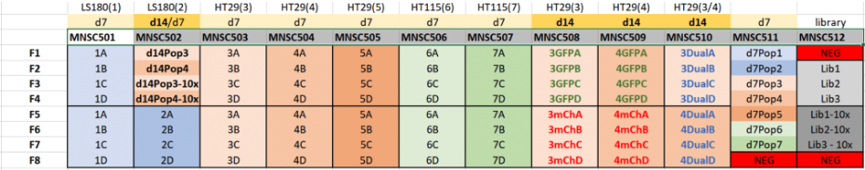
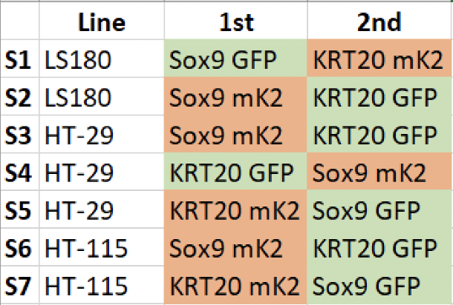
Cell Line Nomenclature
Dual
Single Channel
Dual
S1
S2
S3
S4
S5
S6
S7
S8
S9
S10
Replicate I
Replicate II
For example, Cell Line 5B refers to:
Cell Line
Properties

Slide 14
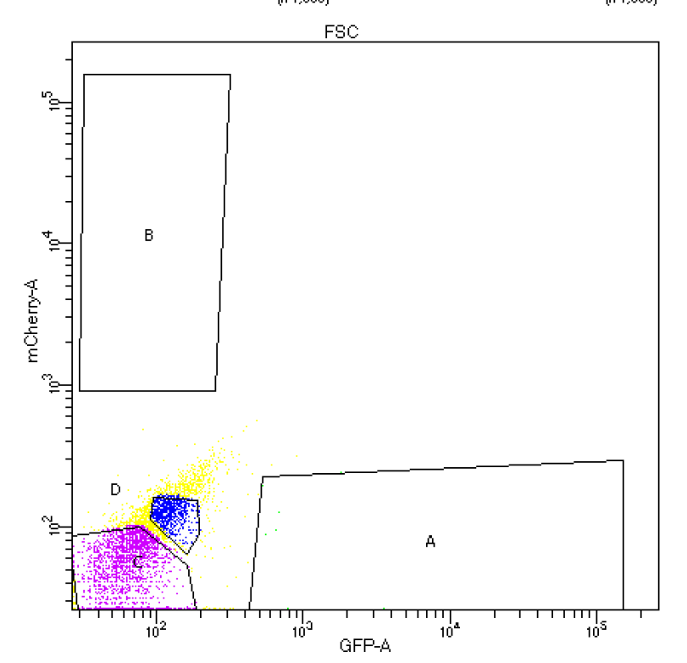
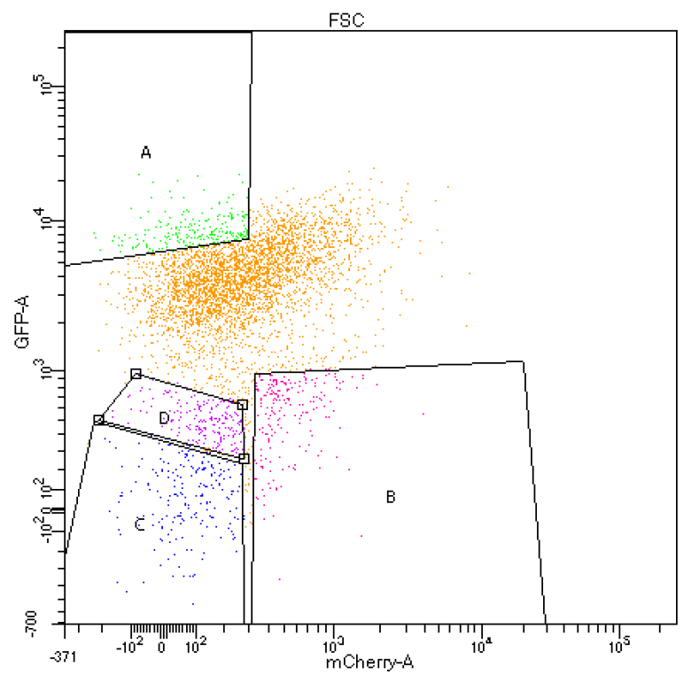
Dual Reporter System Overview
High GFP Intensity
Negative
LS180 S1
Cell Lines
No Fluorescent Intensity
High mCherry Intensity

Slide 15
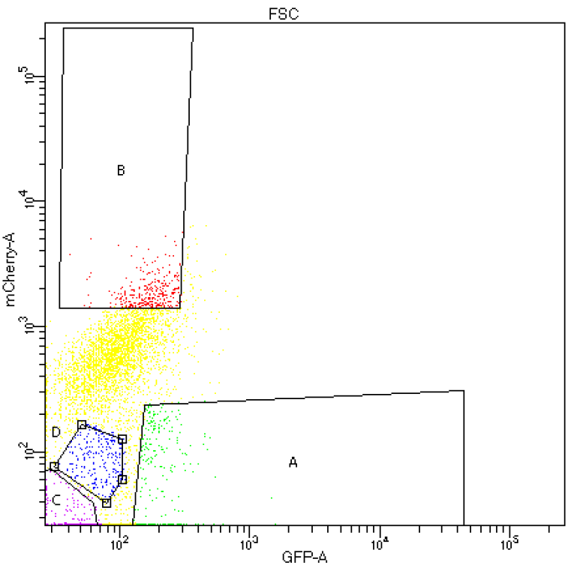
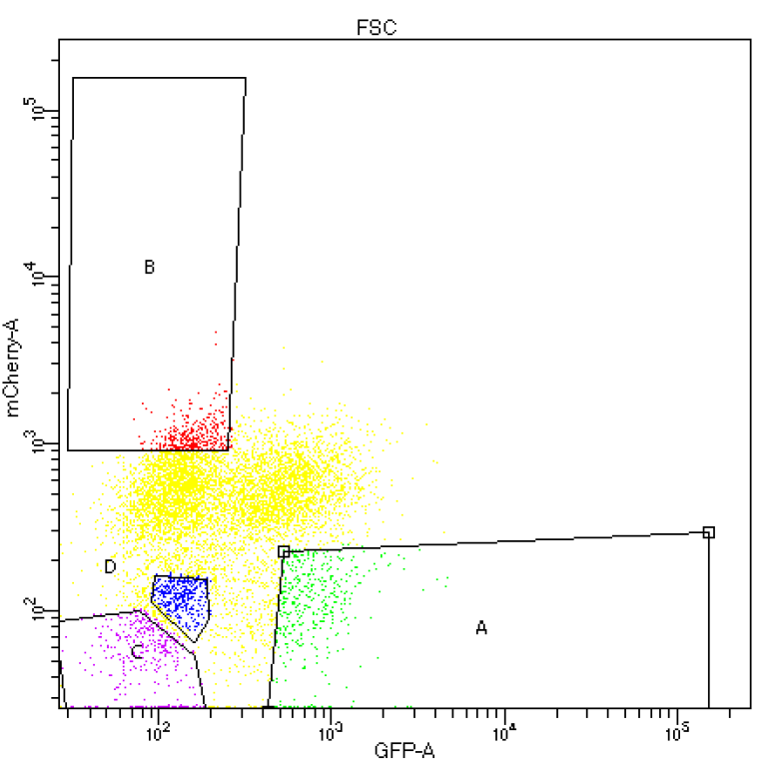
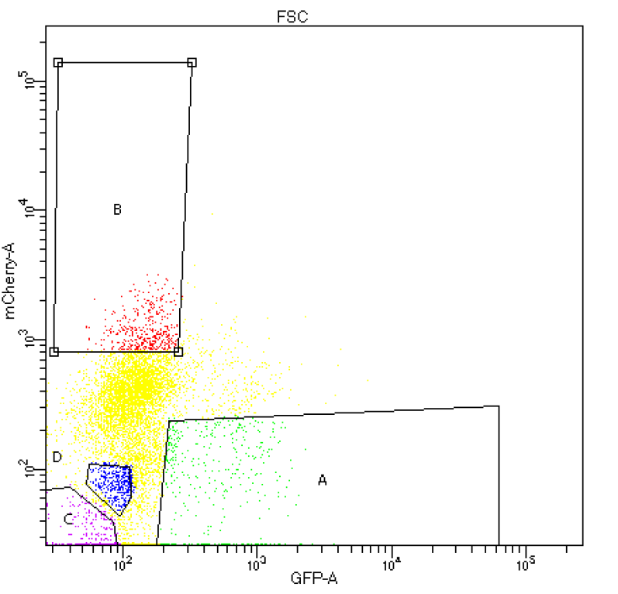
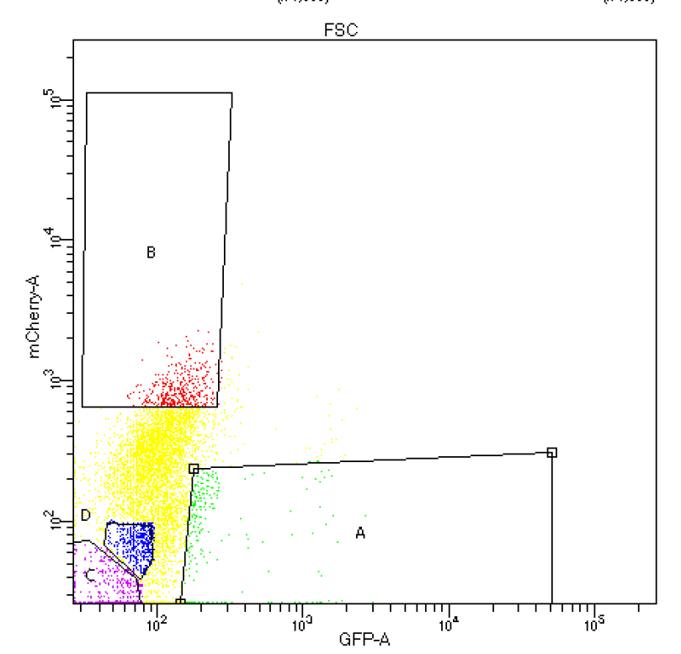
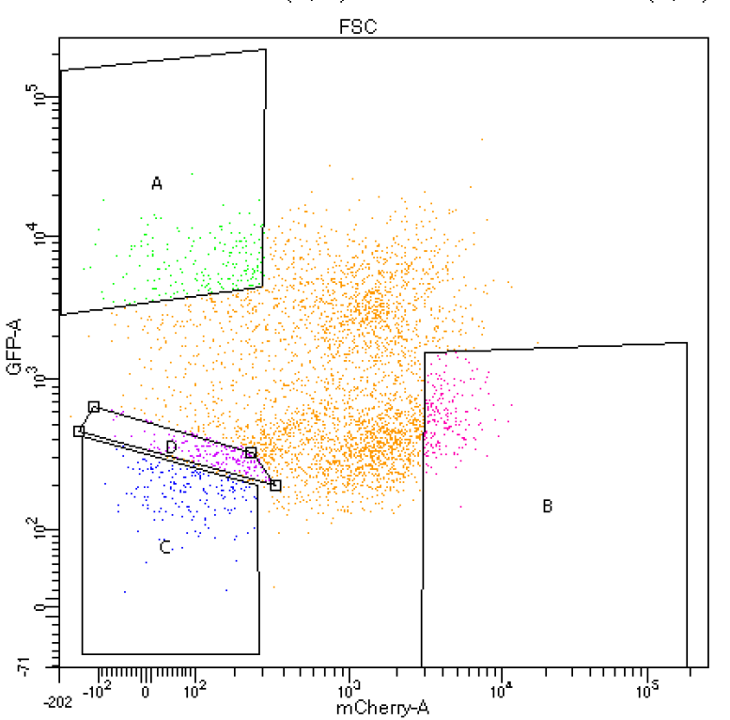
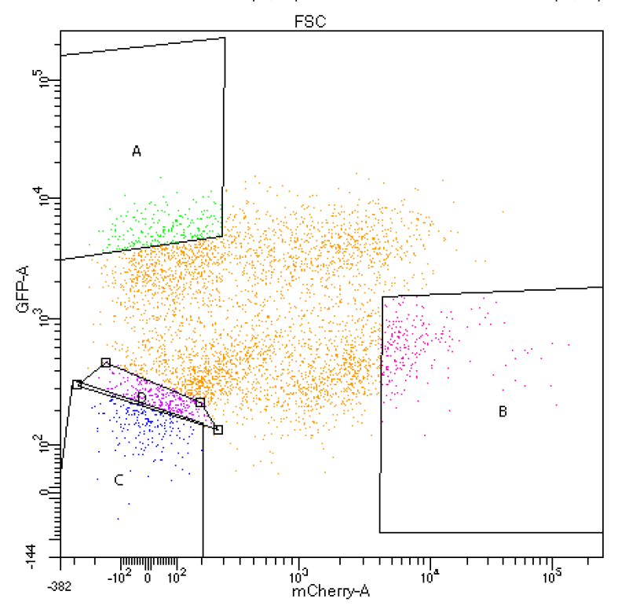
Fractions of Dual Reporter Cell Lines at Day 7
NEG
LS180(1)
LS180(2)
HT29(3)
Cell Lines
HT29(4)
HT29(5)
HT115(6)
HT115(7)
5 way comparison:
A vs. B
A vs. C
A vs. D
B vs. C
B vs. D

Slide 16
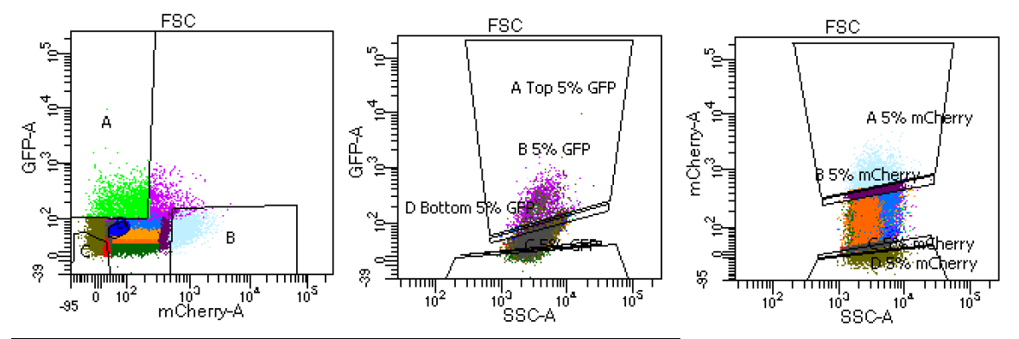
Single Channel vs Dual Reporter
Dual
Single
Single
Notes:
fix graphs, use the same graphs

Slide 17
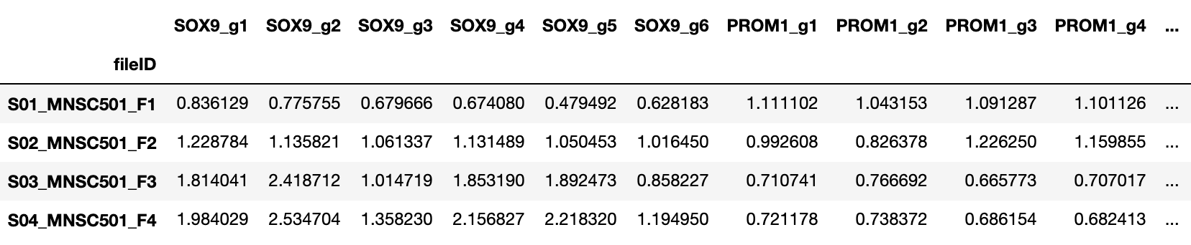
Data Normalization Pipeline
Total Read Normalization
Library Pool Normalization
 | SOX9 Guide 1 | SOX9 Guide 2 | SOX9 Guide 3 | Row Sum
Fraction 1 | 10 | 15 | 25 | 50
TRM Fraction 1 | 0.2 | 0.3 | 0.5 | 1.0
76 gRNA
Normalized Read Counts of 76 gRNA
Population Normalization
Notes:
fix graphs, use the same graphs

Slide 18
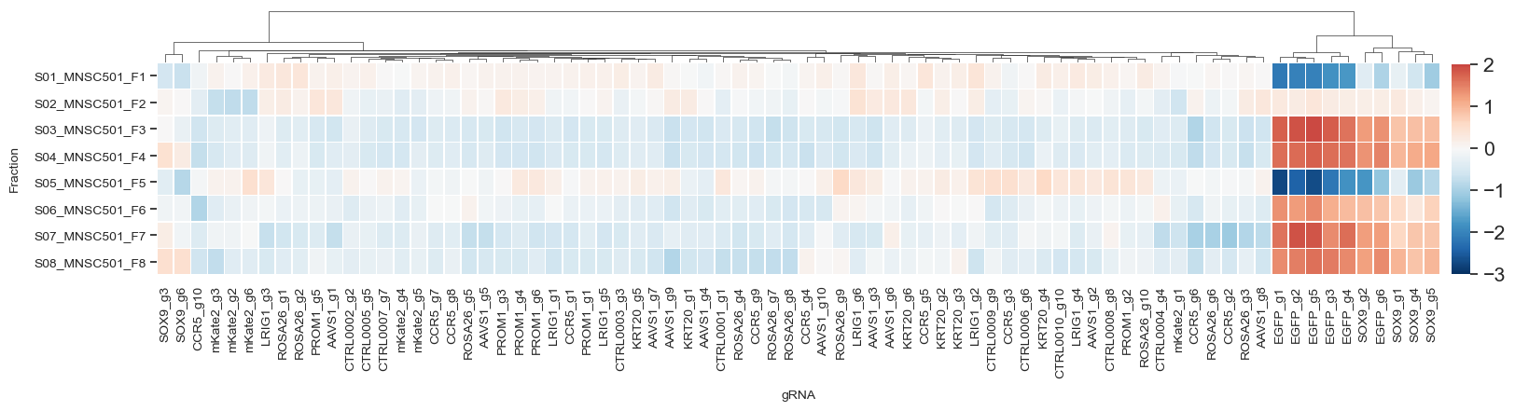
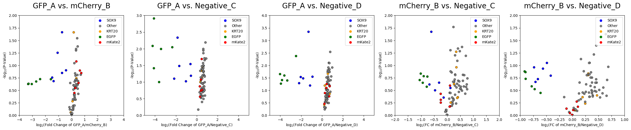
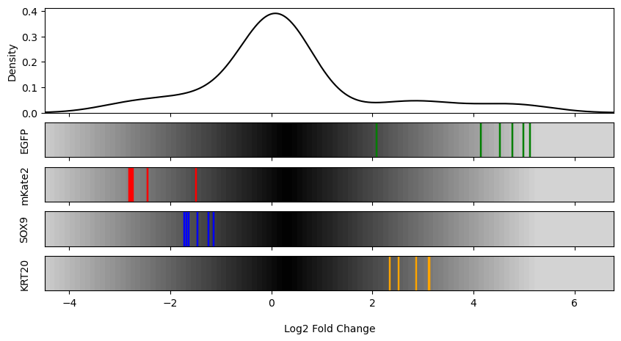
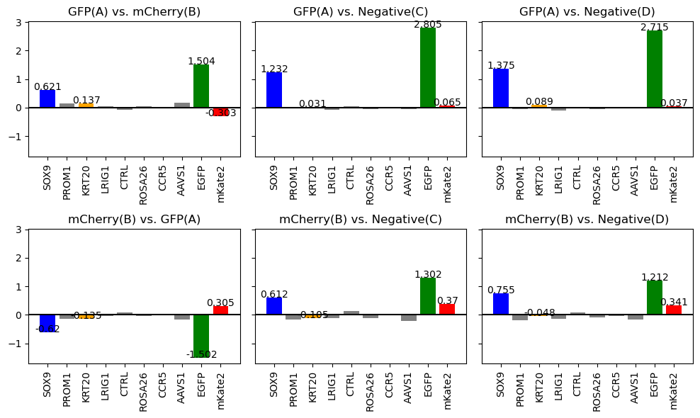
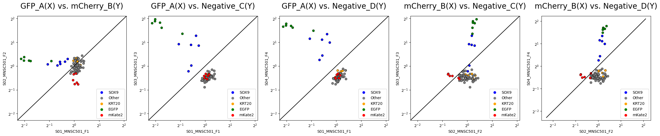
Data Processing and Visualization Pipeline
Normalized Read Counts of 76 gRNA
Heatmap
Volcano Plot
LFC Density
MaGeCK Beta Score
Scatter Plot
Notes:
fix graphs, use the same graphs

Slide 19
Objectives
Which reporter system produced a stronger effect (single vs dual)?
What is the optimal timepoint to conduct the screen (Day 7 vs Day 14)?
Which system within each cell produced a stronger effect?
Goal: Determine if and under what conditions a dual reporter system produces a stronger effect than a single reporter system.
I will demonstrate my analytical pipeline using 7 double knock-in cell lines:
LS180
SOX9 GFP, KRT20 mK2
SOX9 mK2, KRT20 GFP
HT-29
SOX9 mK2, KRT20 GFP
KRT20 GFP, SOX9 mK2
KRT20 GFP, SOX9 GFP
HT-115
SOX9 mK2, KRT20 GFP
KRT20 mK2, SOX9 GFP
Notes:
add in cell line images,
1. which was the better cell line
2. which system within a cell line was better
day 7 vs day 14

Slide 20
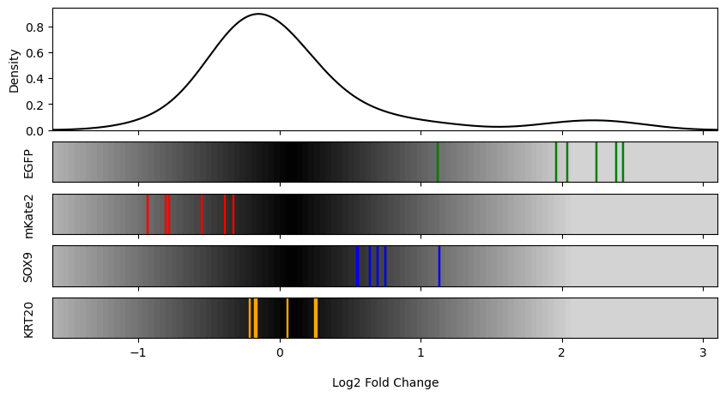
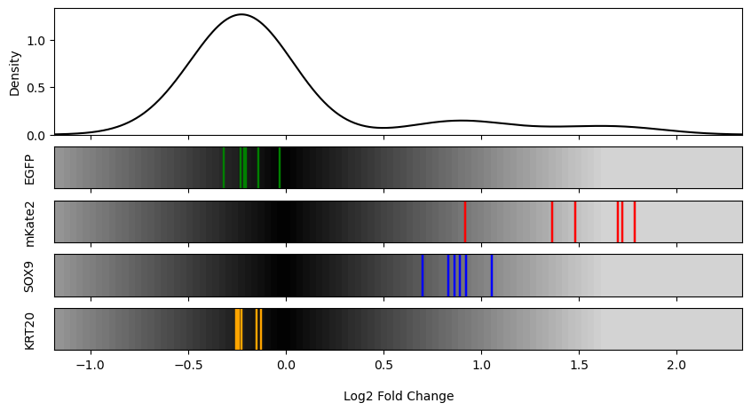
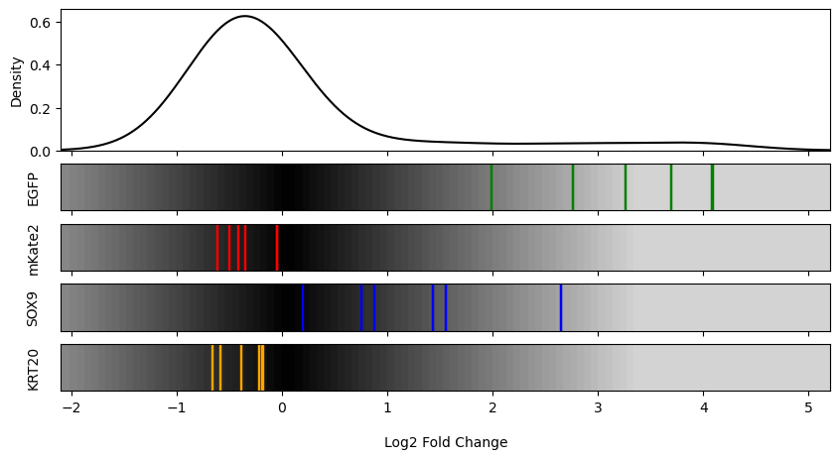
LS180 S1 vs. S2: GFP(A) | mCherry (B)
S1
S2
I
II
Notes:
change replicate name to roman numerals

Slide 21
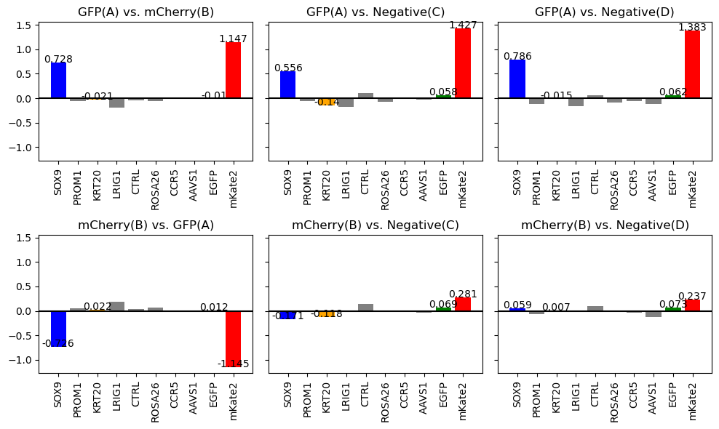
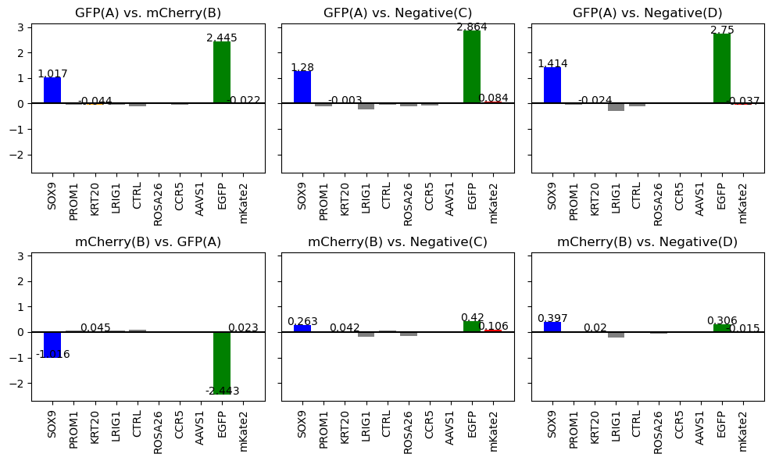
LS180 S1 vs. S2 Beta Score
S1
S2
I
II

Slide 22
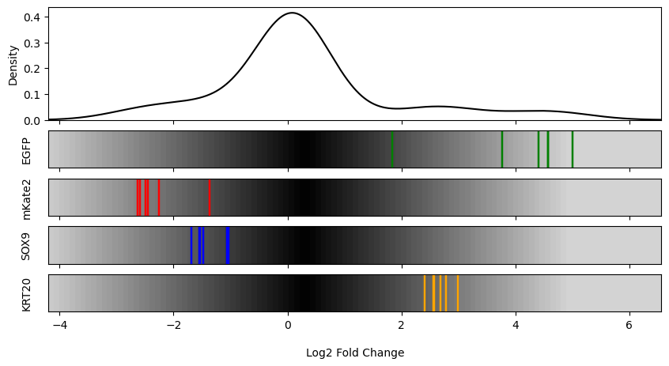
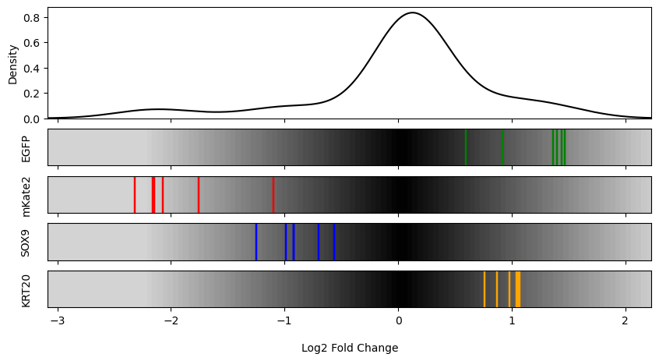
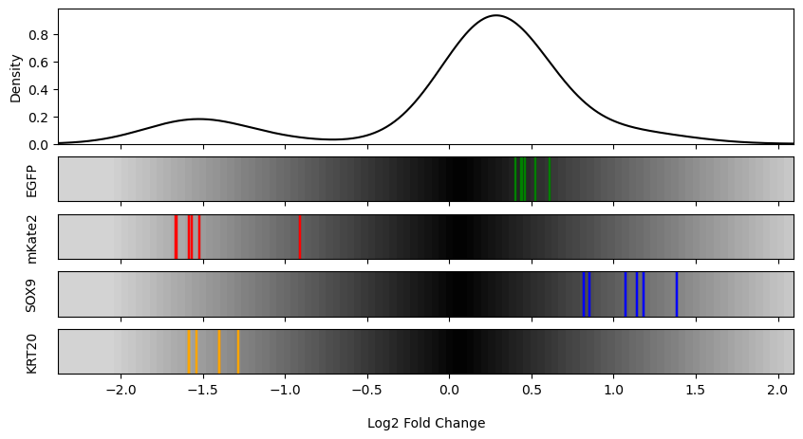
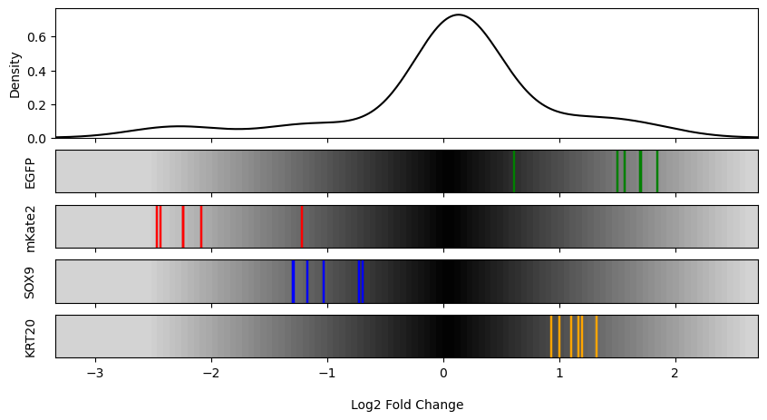
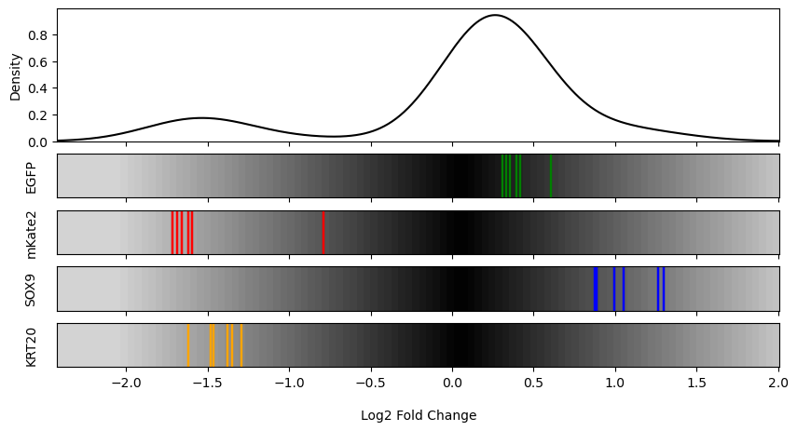
HT-29 S3 vs. S4 vs. S5: GFP(A) | mCherry (B)
S3
S4
S5
I
II

Slide 23
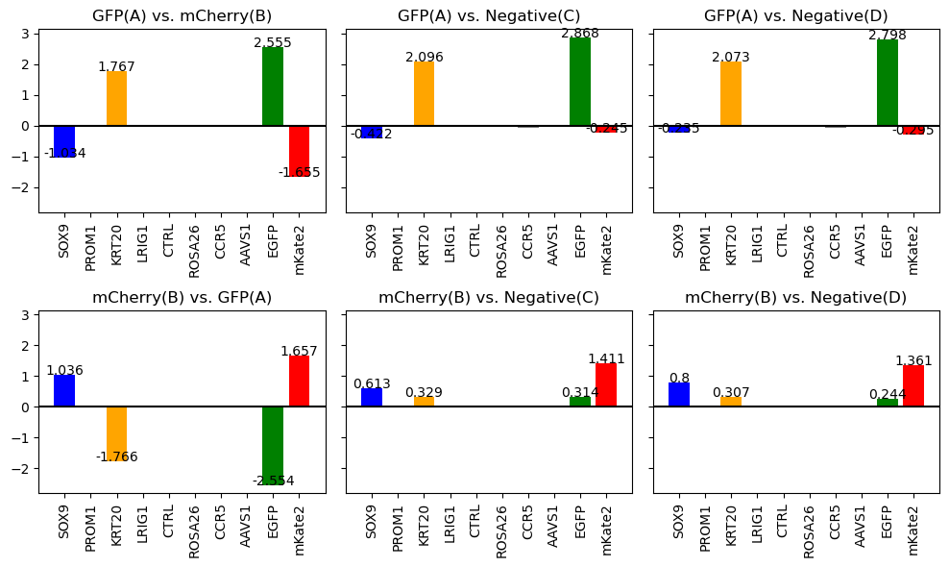
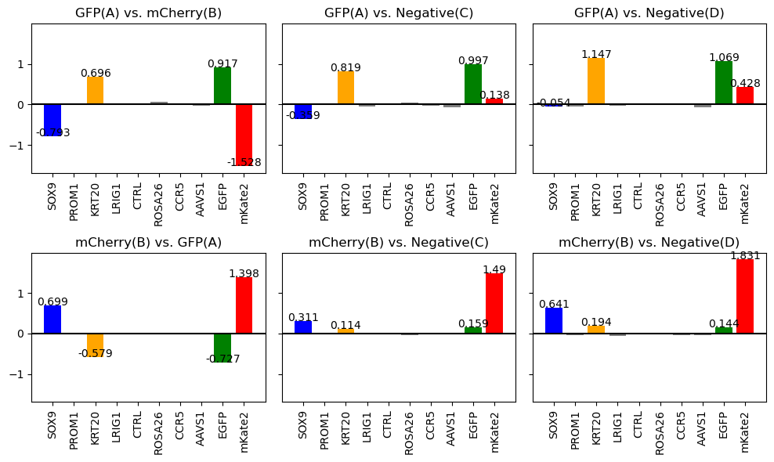
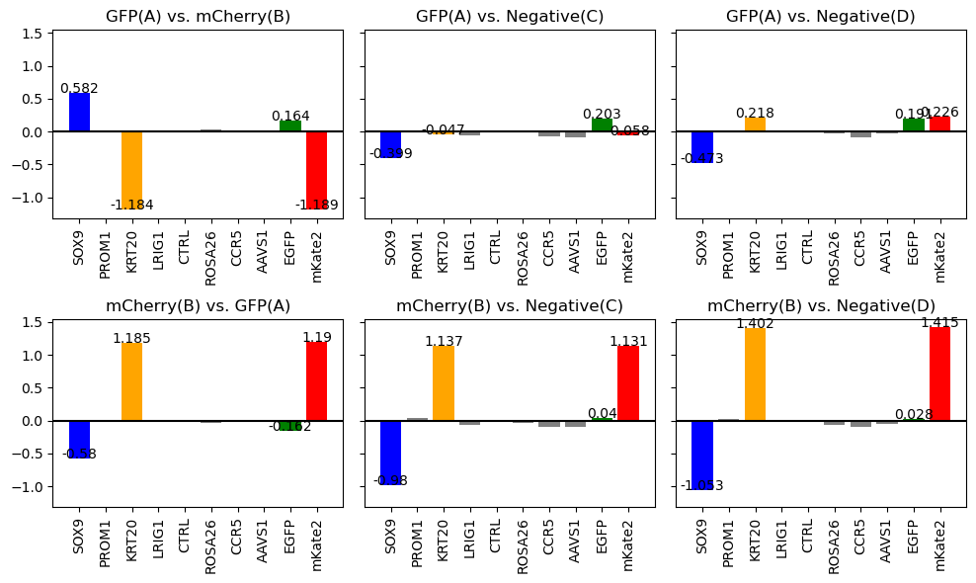
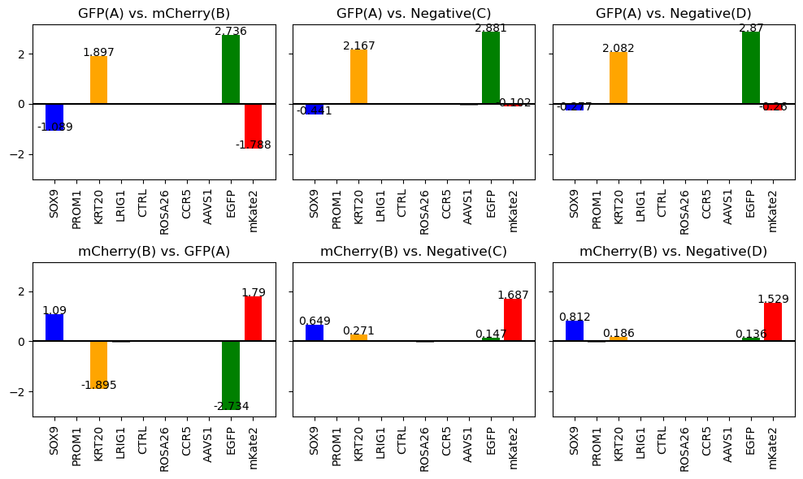
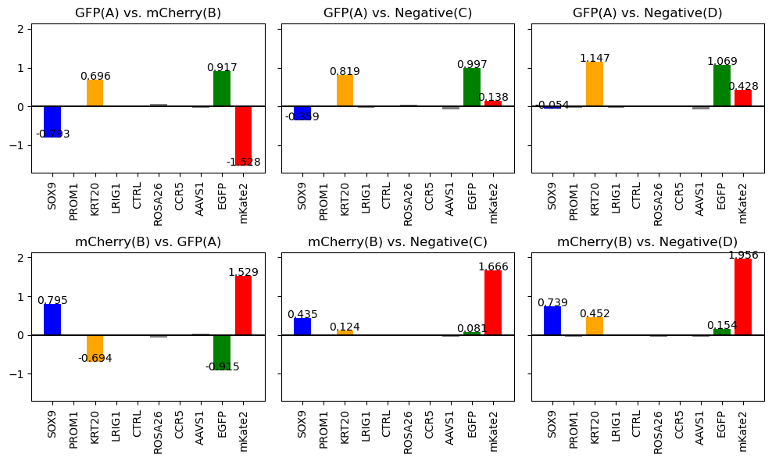

S3 vs. S4 vs. S5 Beta Score
S3
S4
S5
I
II

Slide 24




HT-115 S6 vs. S7: GFP(A) | mCherry (B)
S6
S7
I
II
Notes:
moderate magnitude of effect but expected effect is observed in expected directions

Slide 25




S6 vs. S7 Beta Score
S6
S7
I
II

Slide 26

S3 (Dual at Day 7) vs. Primer 4 (Single at Day 7): GFP(A) | mCherry (B)
S3
Primer 4
Primer 4 at Day 7 (Top 2.5 vs Bottom 2.5)
I
II

Slide 27

S3 vs. Primer 4 Beta Score
S3
Primer 4 at Day 7 (Top 2.5 vs Bottom 2.5)
I
II

Slide 28







HT-29(3) S10A vs S8 at Day 14: Dual Reporter vs Single Channel mCherry vs Single Channel GFP
GFP_A vs. mCherry_B
GFP_A vs. Negative_C
GFP_A vs. Negative_D
mCherry_B vs. Negative_C
mCherry_B vs. Negative_D
mCherry Top 5% vs Bottom 5%
GFP Top 5% vs Bottom 5%

Slide 29



HT-29(3) S10A vs S8 at Day 14: Dual Reporter vs Single Channel mCherry vs Single Channel GFP
Dual
Single Channel GFP
Single Channel mCherry

Slide 30







HT-29(4) S10B vs S9 at Day 14: Dual Reporter vs Single Channel mCherry vs Single Channel GFP
GFP_A vs. mCherry_B
GFP_A vs. Negative_C
GFP_A vs. Negative_D
mCherry_B vs. Negative_C
mCherry_B vs. Negative_D
mCherry Top 5% (A) vs Bottom 5% (B)
GFP Top 5% (A) vs Bottom 5% (B)

Slide 31



HT-29(4) S10B vs S9 at Day 14: Dual Reporter vs Single Channel mCherry vs Single Channel GFP
Dual
Single Channel GFP
Single Channel mCherry

Slide 32


S3 (Dual at Day 7) vs. S8 (Single at Day 14): GFP(A) | mCherry (B)
S3
S8
GFP
I
mCherry
II

Slide 33
S3 vs. S8 Beta Score
S3
S8
I
II

Slide 34
S3 (Dual at Day 7) vs. S10A (Dual at Day 14): GFP(A) | mCherry (B)
S3
S10
I
II

Slide 35
S3 vs. S10 Beta Score
S3
S10
I
II

Slide 36
Summary
Cell Line with the Strongest Effect
S1 vs S2
LS180 (SOX9 GFP, KRT20 mK2)
S3 vs S4 vs S5
HT-29 (SOX9 mK2, KRT20 GFP)
S6 vs S7
HT-115 (SOX9 mK2, KRT20 GFP) or HT-115 (KRT20 mK2, SOX9 GFP)
S3 vs Primer 4
Dual Reporter at Day 7 > Single Channel at Day 7
S8 vs S10A
Single Channel at Day 14 > Dual Reporter at Day 14
Cell Lines
S9 vs S10B
Single Channel at Day 14 > Dual Reporter at Day 14
S3 vs S8
Dual Reporter at Day 7 > Single Channel at Day 14
S3 vs S10A
Dual Reporter at Day 7 > Dual Reporter at Day 14
Notes:
s3 vs primer 4
fix slide
answer the 3 questions

Slide 37
Conclusion
Which reporter system produced a stronger effect (single vs dual)?
What is the optimal timepoint to conduct the screen (Day 7 vs Day 14)?
Which system within each cell produced a stronger effect?
Dual Reporter system produces a stronger effect on Day 7
Single Channel produces a stronger effect on Day 14
Day 7 consistently produced the expected enrichment and depletion profiles of target gRNA with greater magnitude than Day 14
S1 vs. S2
LS180 (SOX9 GFP, KRT20 mK2)
S3 vs. S4 vs. S5
HT-29 (SOX9 mK2, KRT20 GFP)
S6 vs. S7
HT-115 (SOX9 mK2, KRT20 GFP) or
HT-115 (KRT20 mK2, SOX9 GFP)
S1 << S6 vs. S7 < S3
Notes:
s3 vs primer 4
fix slide
answer the 3 questions

